Slide 1
Routing Assist Mobile Application Using Smart Wear and Voice Control
Group: Feed&Quit

Slide 2
We are from FPT University
PhD.Kiều Trọng Khánh: FPT University teacher, team mentor.
Huỳnh Quang Thảo: leader
Hà Kim Quy
Nguyễn Quang Huy

Slide 3
Project Summary
We provide system with following applications:
Android application:
allow customer searches bus route or motorbike route using mobile keyboard or voice.
assist customer when participating traffic by notify message when customer is near a bus station or motorbike’s turn.
assist notify customer and show support message when customer goes wrong way when participating traffic.
Wear application: display result on map and notify. Notified signal can be text message, vibrate wear device or alarm by a sound message (using FPT Text To Speech API).

Slide 4


Slide 5
Problem 1: Missing Routing assist mobile application
Currently mobile application on market:
BusMap: offcial mobile application of Ho Chi Minh Ministry of Communications and Transport that support finding bus route.
Google Map: supporting finding bus route and motorbike route.
Limitation:
BusMap: just support finding bus route. Algorithm isn't well and doesn’t have some useful search conditions such as number of transfers, departure time or arrival time.
Google Map:
Just support finding route. Google Map doesn't assist customer when participating traffic such as notify message when near next bus station, or near one motorbike turn. So customer must often look up to phone to know where they are on map.
Alert message when customer goes wrong way.
Not support map offline. Customer must have 3G when participating traffic.

Slide 6
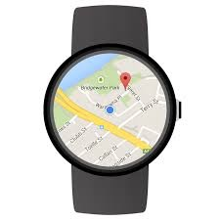
Problem 2: Supporting view result on wear device
Currently market doesn’t have any routing assist mobile applications that supporting display result and notify message on wear. This function has some advantages:
Customers don’t need to open phone when they’re on street so they can eliminate accident when participating traffic.
When customers are near a bus station or a motorbike turn, wear will show message so customer easily understand how to do next.

Slide 7

Problem 3: voice integration for enhancing usability.
Currently market doesn’t have an applications that satisfied:
Voice search: help customers avoid typing on small keyboard, especially they’re on street.
Notify at each turn or station by sound: (for example, say “xuống trạm tới”, “quẹo trái qua đường Nguyễn Thiện Thuật”, “đi qua ngã Tư”): eliminate customer must look up on wear or mobile to view result when participating traffic.

Slide 8

Our team provides solutions to fix 3 above problems.

Slide 9
Providing a routing assist mobile application
Supporting search bus route and motorbike route from two points to four points.
At every bus station customer should leave or at each motorbike’s turn, application will notify a message or vibrate device.
Wrong-way notification system: when customer goes far from searched route, system will notify alert message. When customer come near again searched route, system will recommend suitable message for customer.
Supporting map offline. So customer can uses mobile for assisting route when no network around.

Slide 10
Providing wear application and can display search result.
Display search result on wear’s google map.
At every bus station customer should leave or at each motorbike’s turn, application will notify a message or vibrate device.

Slide 11
Providing voice search command and sound result.
Customer can search by using voice command. For example customer can say: “Cho tôi đi từ 173/2 Bà Hạt đến 283 Nguyễn Thị Minh Khai”. Our team will use Google Speech To Text API for this function.
When customer is near one bus station or one motorbike’s turn, application will say a sentence so customer can know how to do next. For example: “Xin mời quẹo phải qua đường Bà Huyện Thanh Quan”. Our team will use FPT Text To Speech API for this function.

Slide 12
Demo 1: Search motorbike route
Step 1: search motorbike route using voice control:
Start location: Bến xe quận 8
First middle location: 280 Nguyễn Đình Chiểu
Second middle location: VinCom Lê Thánh Tôn
End location: Công Viên Tao Đàn
Step 2: view results:
download all audio files.
start GPS simulation.
see Toast and hear an assist sound when near a turn.
Step 3: view result on wear.

Slide 13
Demo 2: Search bus route
Step 1: search motorbike route using voice control:
Start location: Bến xe quận 8
First middle location: 280 Nguyễn Đình Chiểu
Second middle location: VinCom Lê Thánh Tôn
End location: Công Viên Tao Đàn
Step 2: view result: see Toast and hear an assist sound when near a turn.

Slide 14
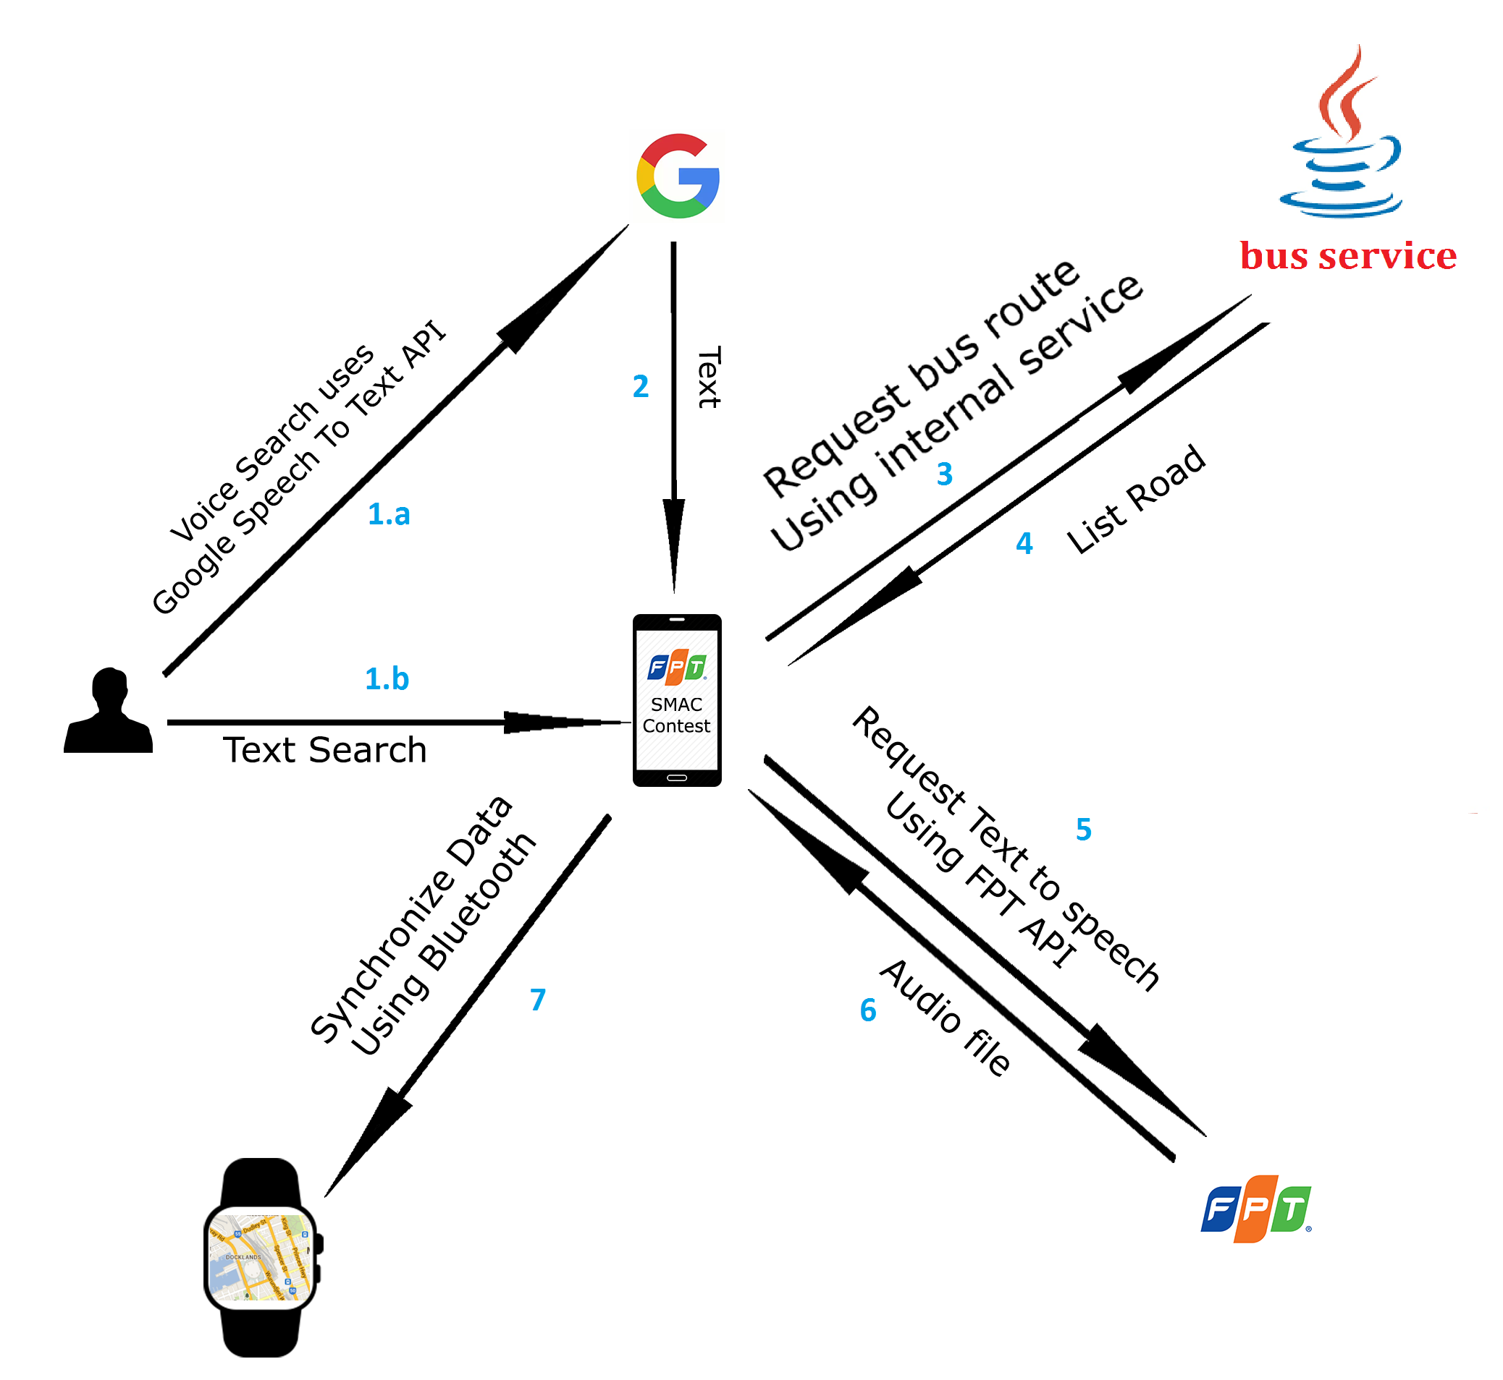
Architecture: Bus Routing

Slide 15
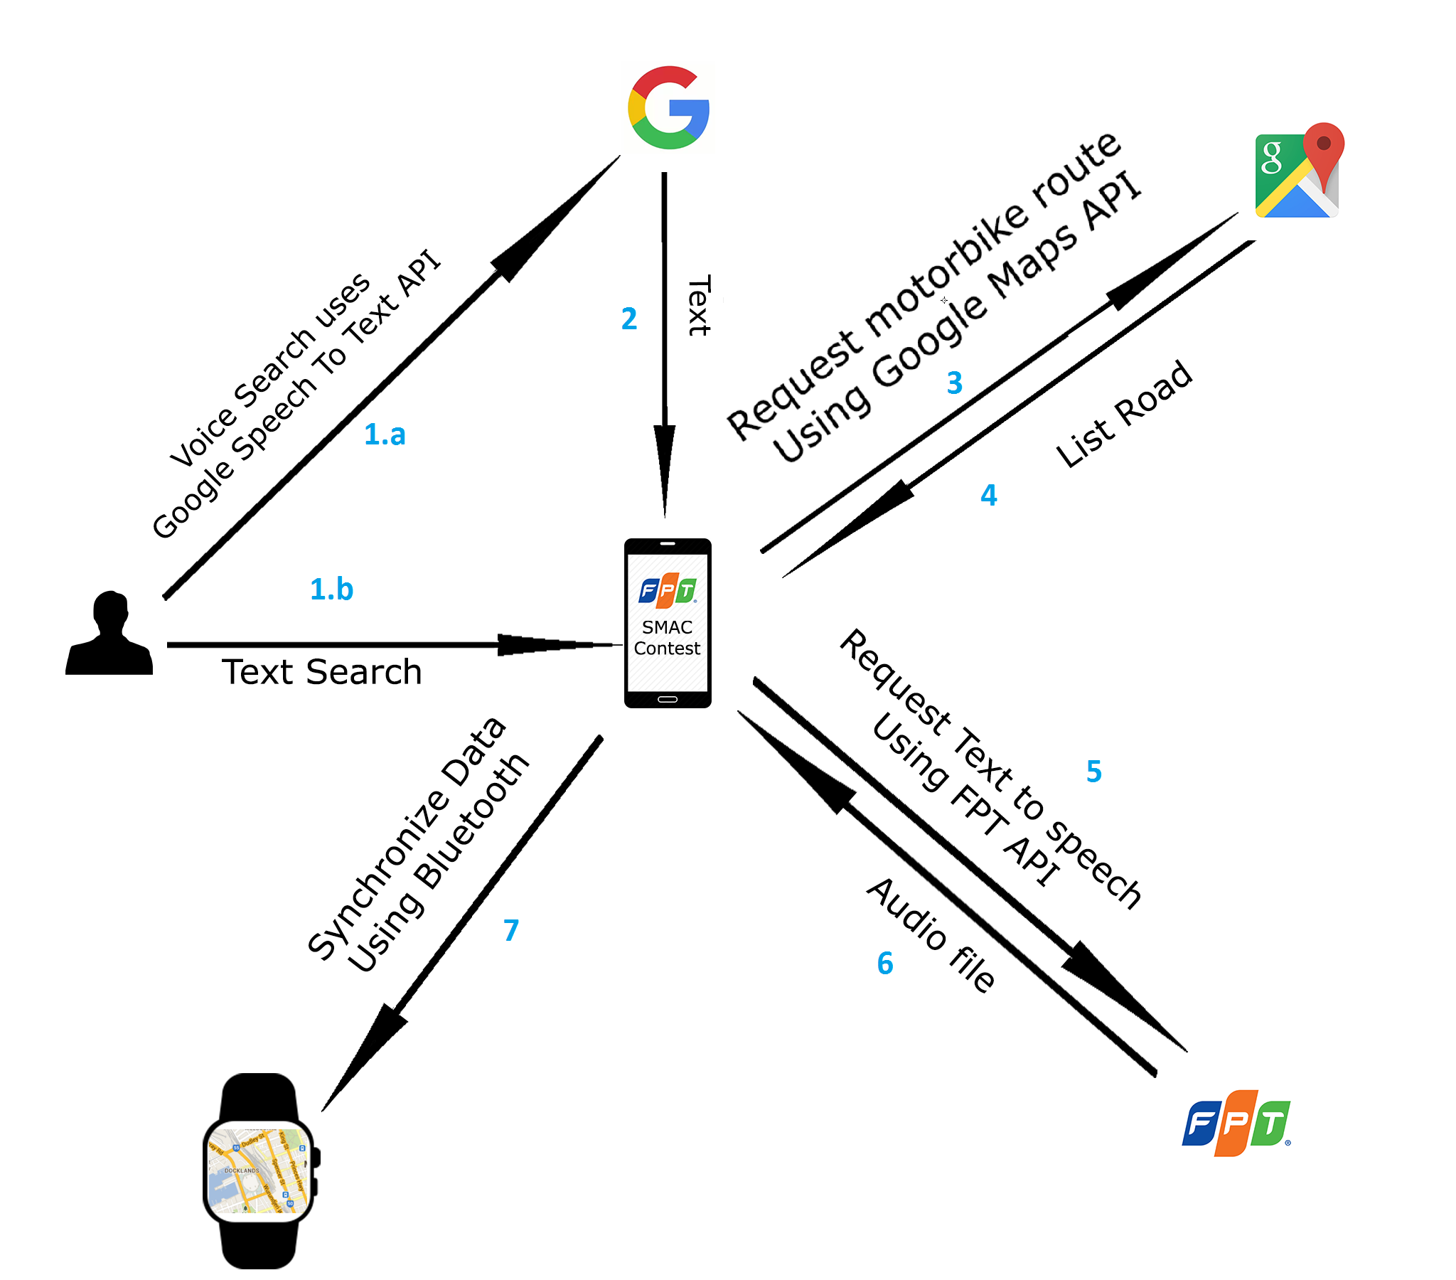
Architecture: Motorbike Routing

Slide 16
Thanks for listening

